Slide 1

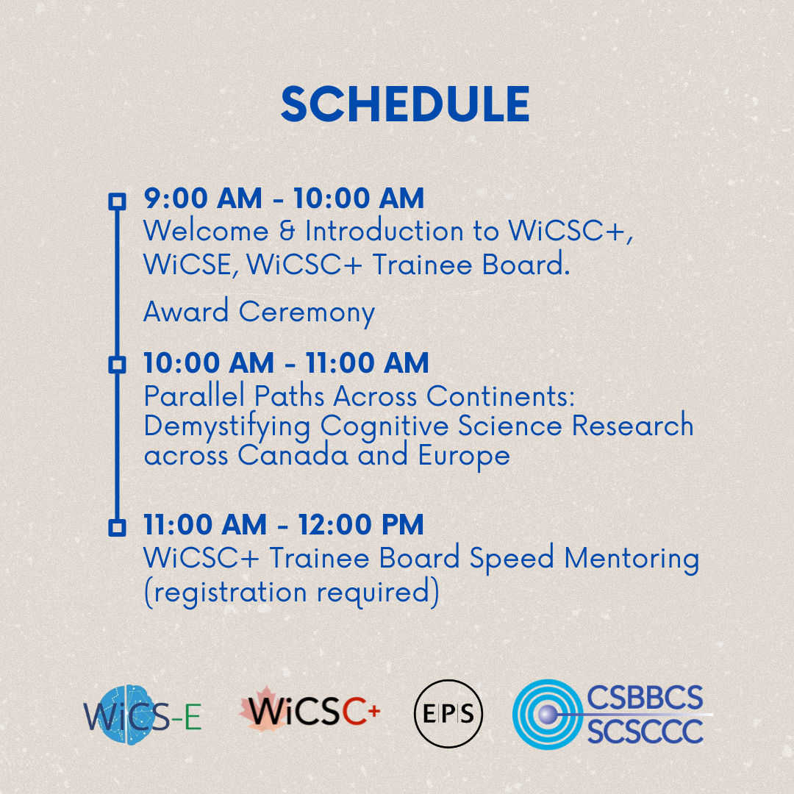

Slide 2
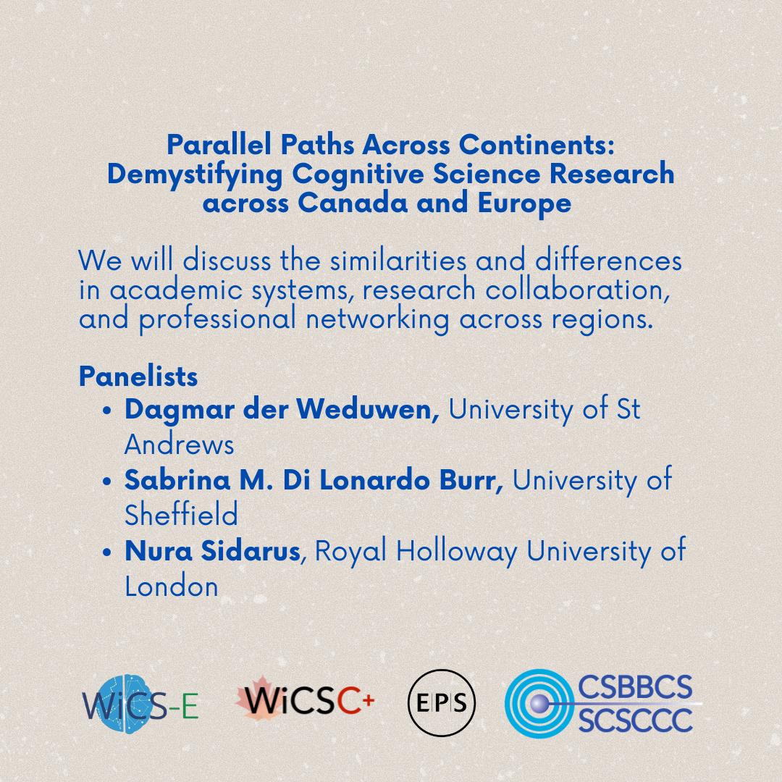

Slide 3
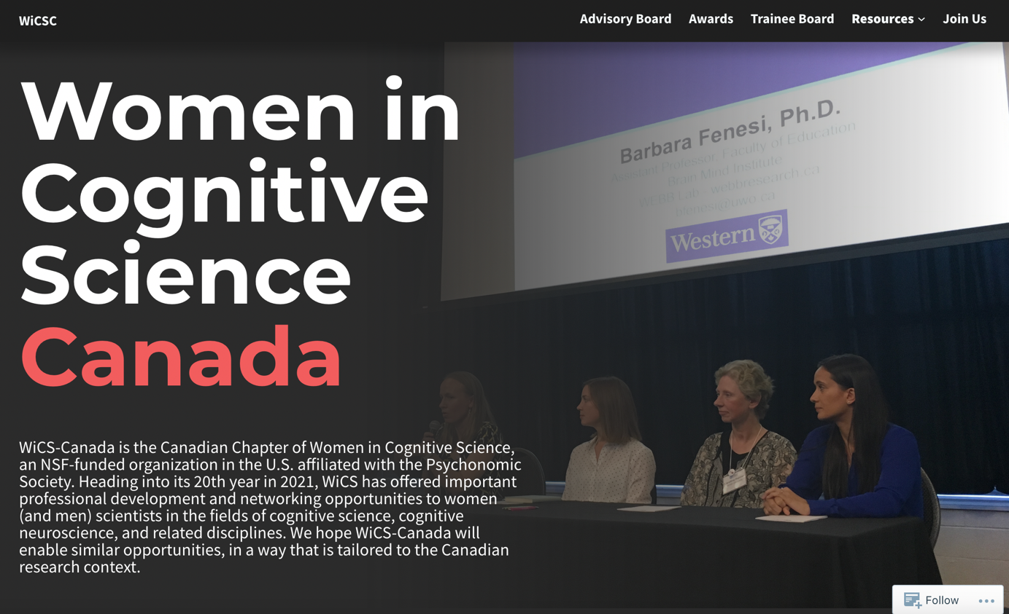


@wicscanada.bsky.social
@wicsc-trainee.bsky.social
https://wicsc.ca/
@WiCSC_Trainee

Slide 4
WiCSC+ Background
US-based Women in Cognitive Science
  www.womenincogsci.org
Seed funding from NSERC (2016-2017)
CSBBCS 1st round of support (2017-2024)
  Penny Pexman & Debra Titone, co-directors
WiCSC+ Trainee Board Established 2024
CSBBCS 2nd round of support (2025 – 2030)
  Erin Maloney & Debra Titone, co-directors

Slide 5
WiCSC + Objectives
Promote diversity and awareness of related professional issues in Cognitive Science
Promote opportunities for networking, mentorship, and professional development
Membership open to all

Slide 6
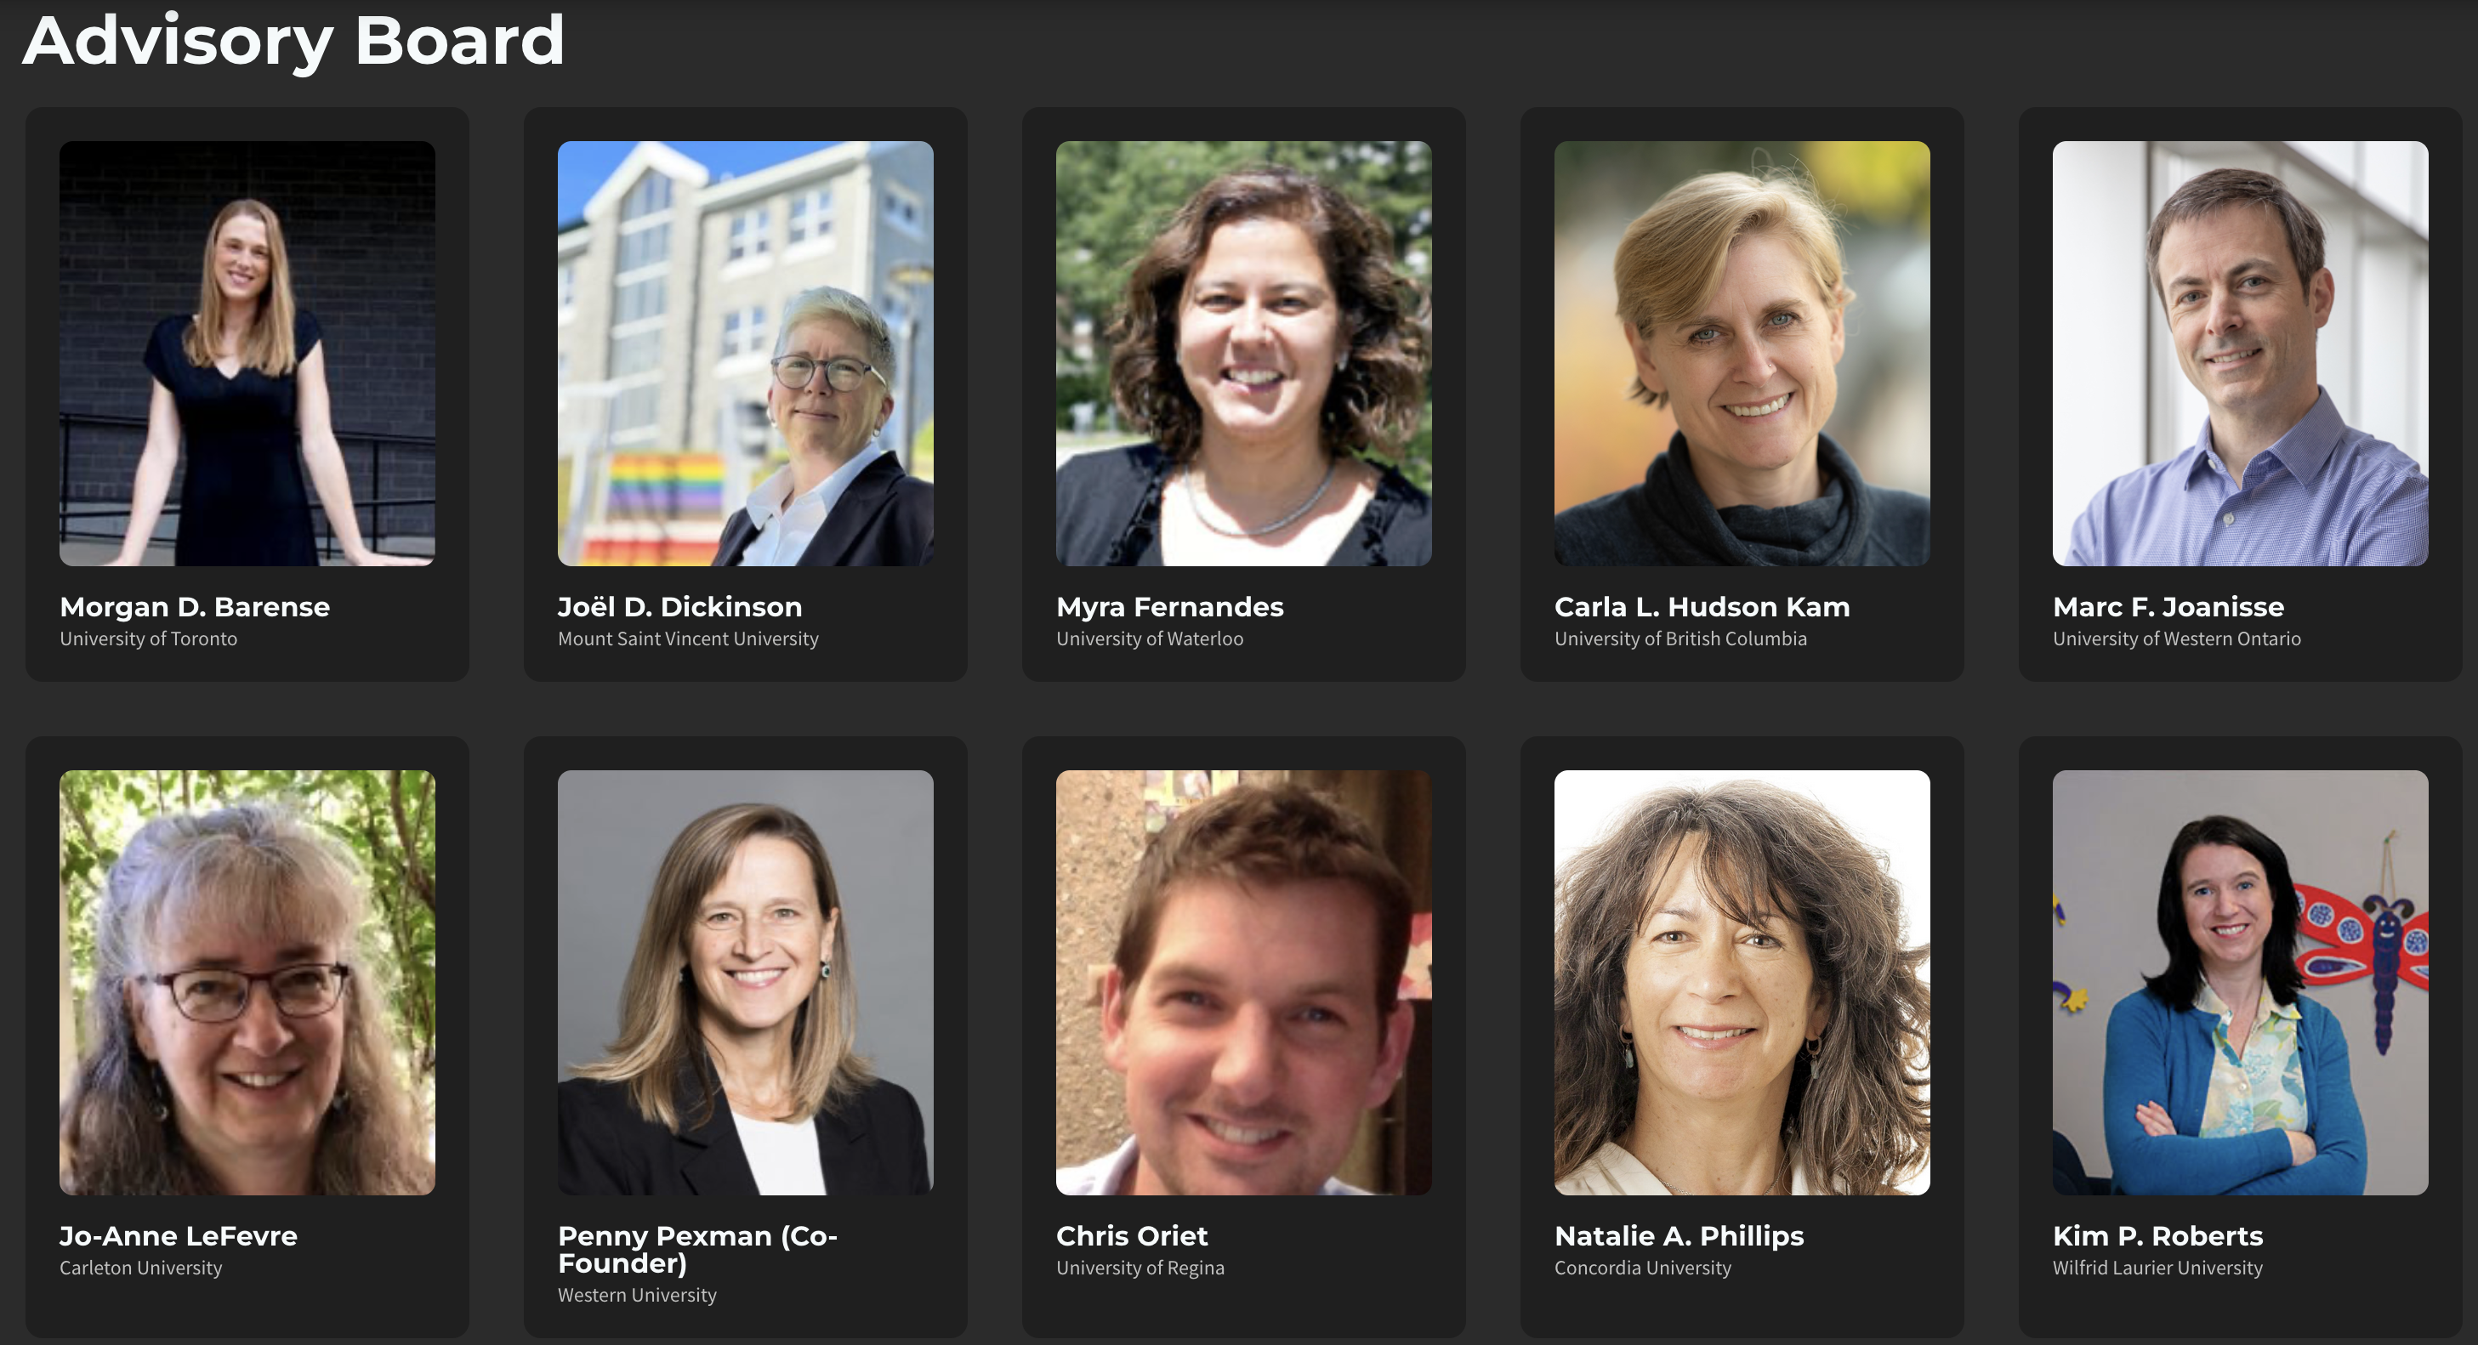
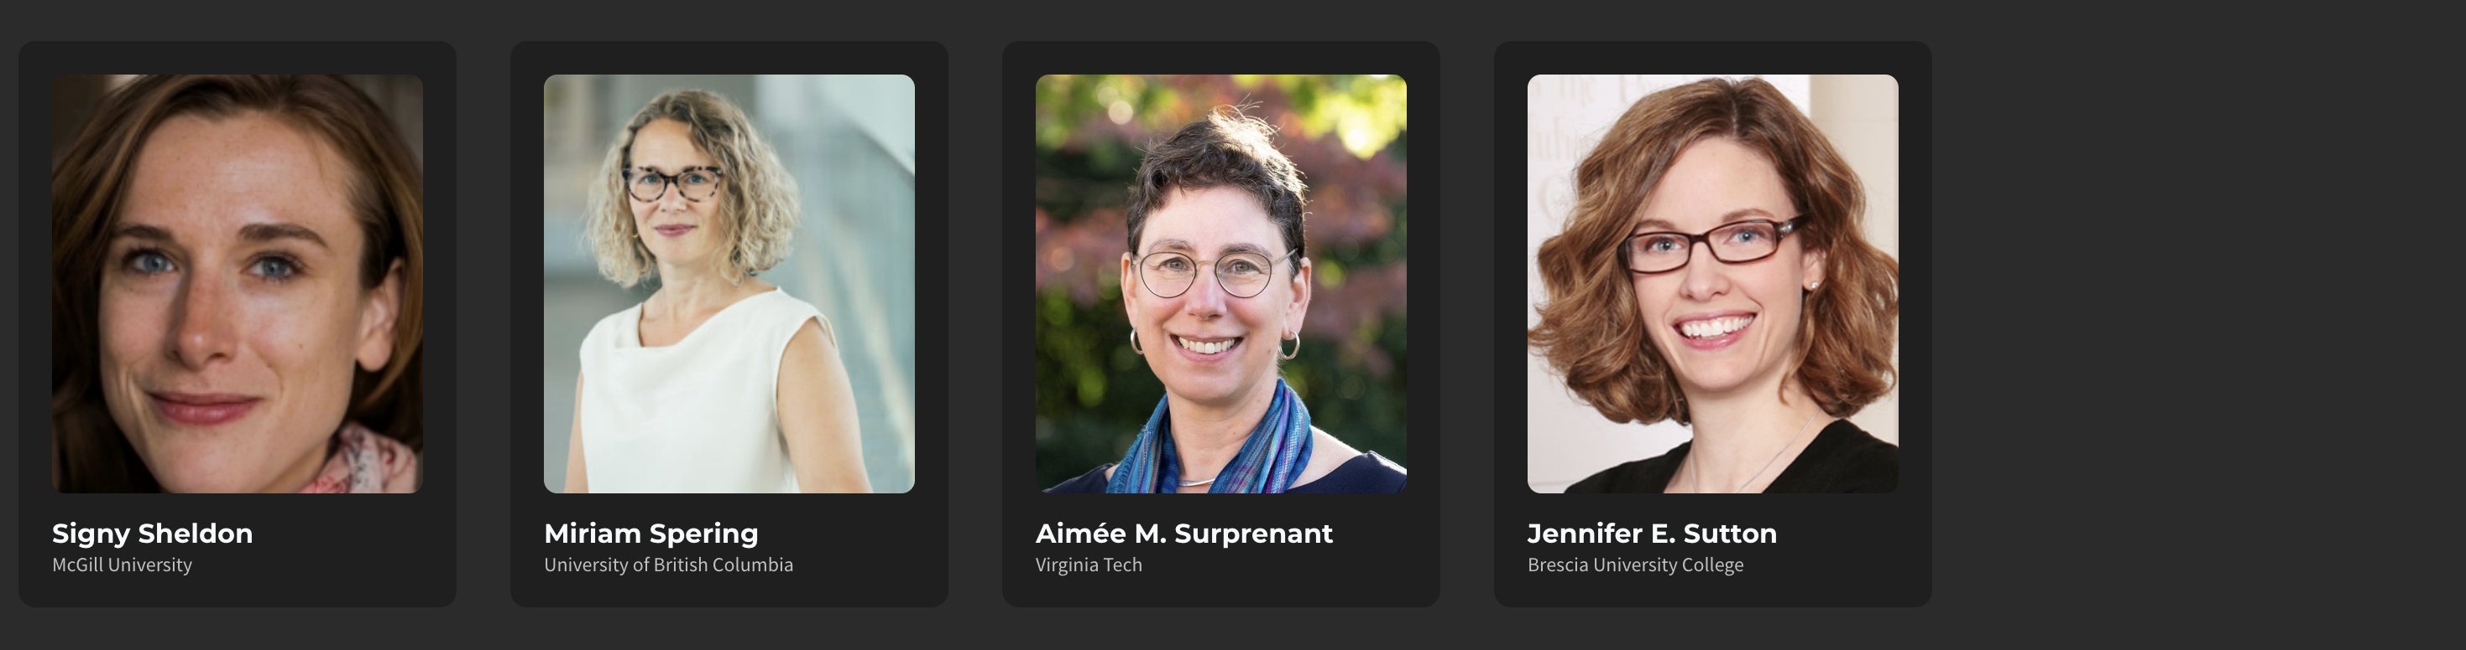
WiCSC+ Advisory Board
2016-2025

Slide 7
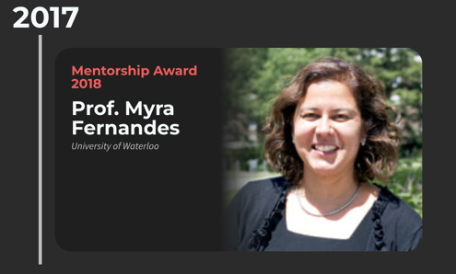
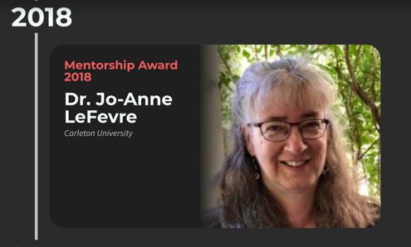
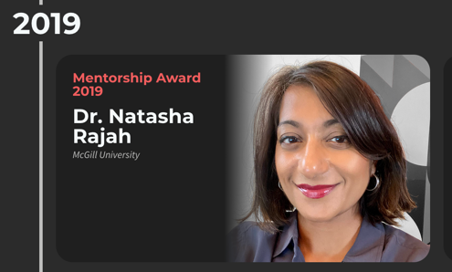
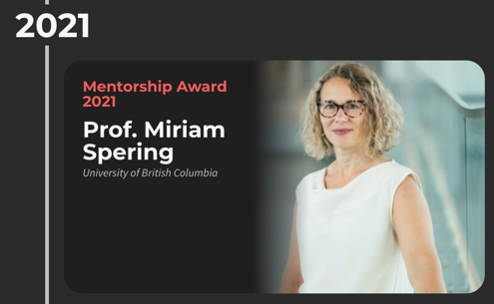
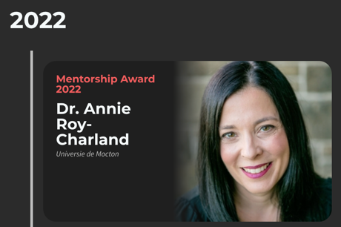
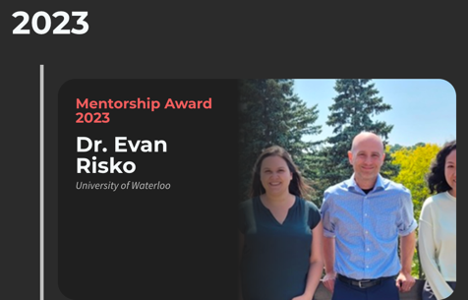
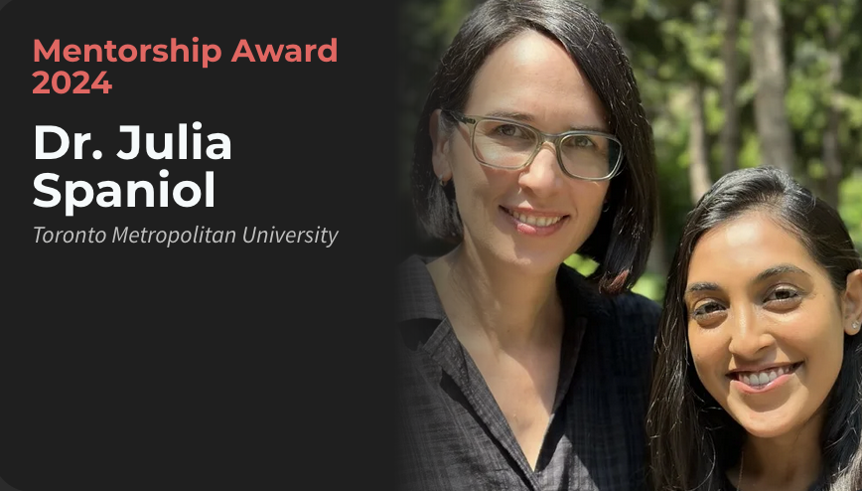
Previous WiCSC+ Mentorship Award Winnters

Slide 8
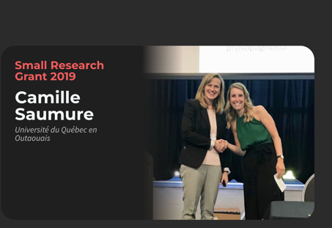
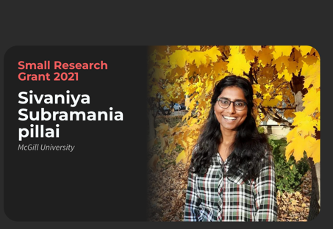
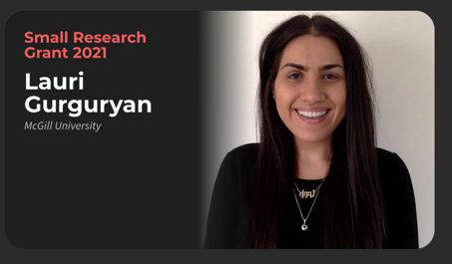
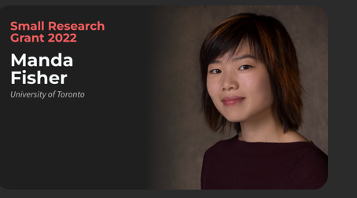
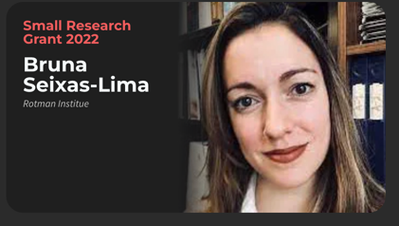
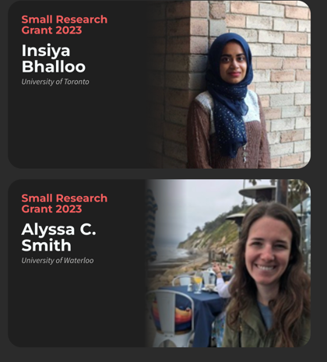
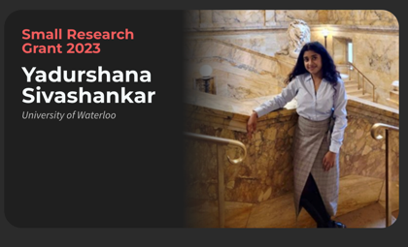
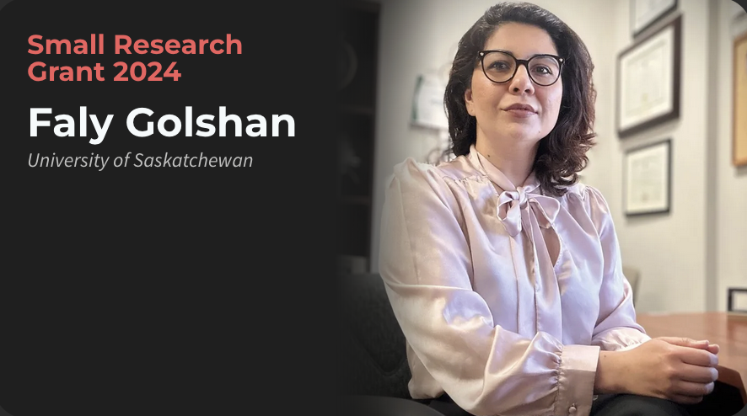
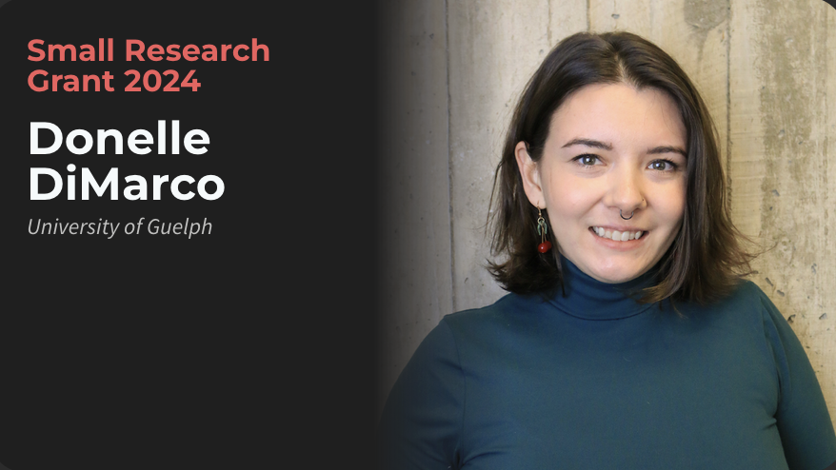
Previous WiCSC+ Small Research Grants for Jr. Investigators

Slide 9
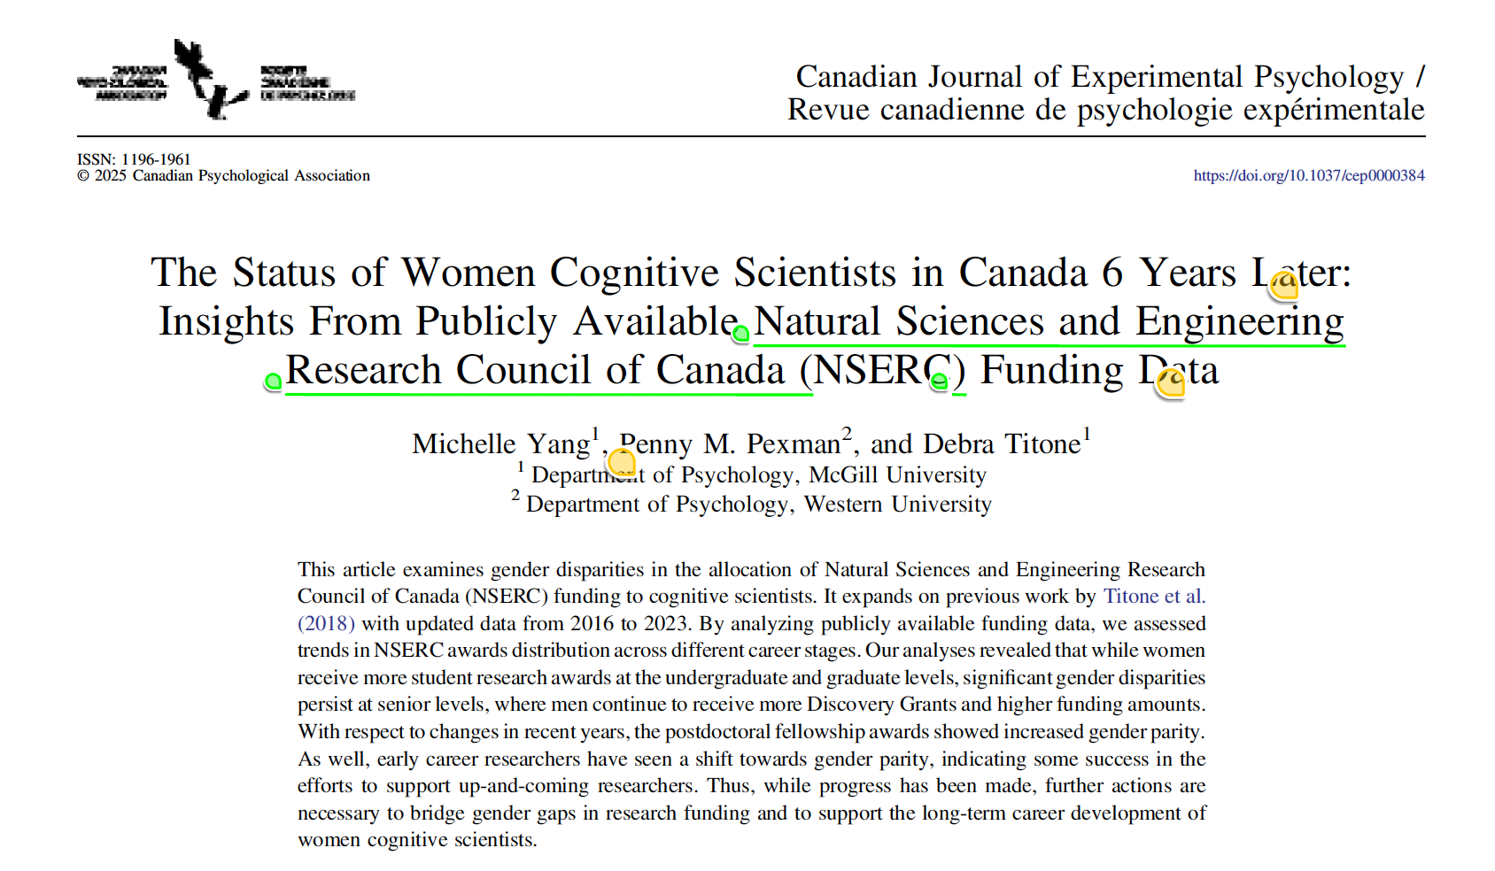
What we’ve been up to @ WICSC+

Slide 10
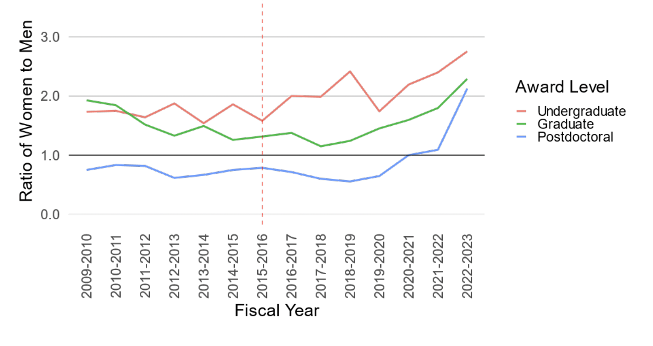
What we’ve been up to @ WICSC+

Slide 11
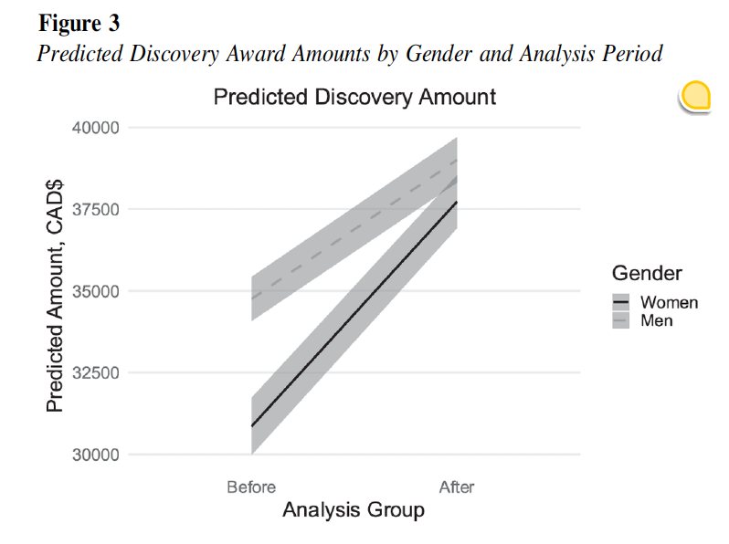
What we’ve been up to @ WICSC+

Slide 12
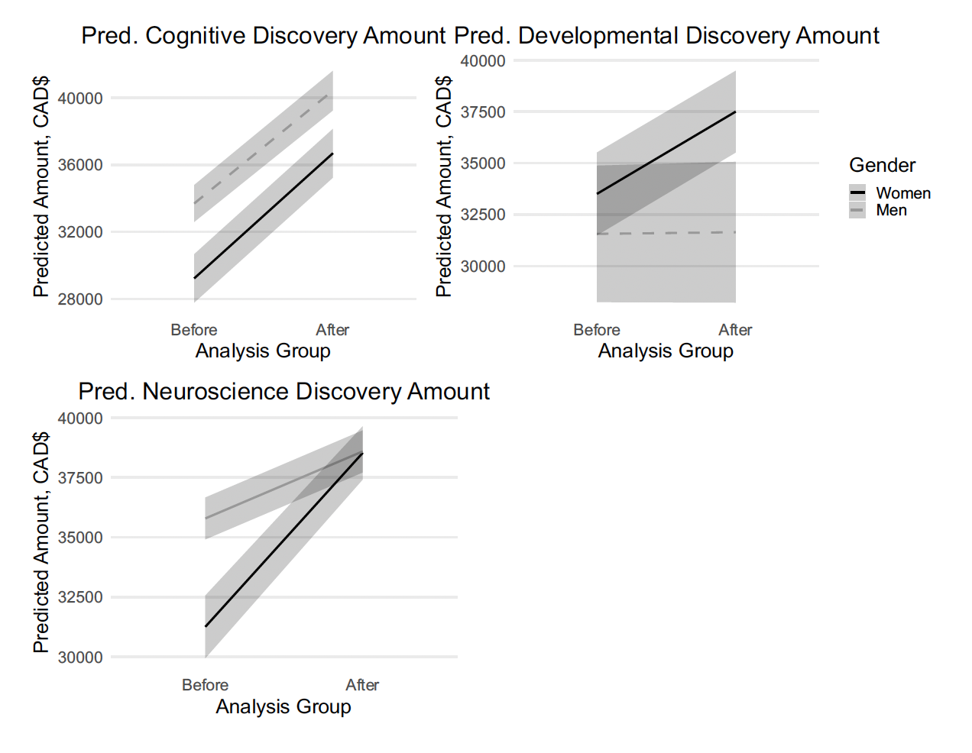
What we’ve been up to @ WICSC+

Slide 13
Next Steps – WICSC+ 2.0
In WICSC 2.0, we enthusiastically follow the lead of WICS (our parent organization) to intentionally expand the circle
    Beyond the gender binary
    First Nations, Inuit, & Metis
    People of Colour
    People living with disabilities
    First generation scholars
    Renew our leadership, advisory board
    Increase trainee involvement

Slide 14


Slide 15
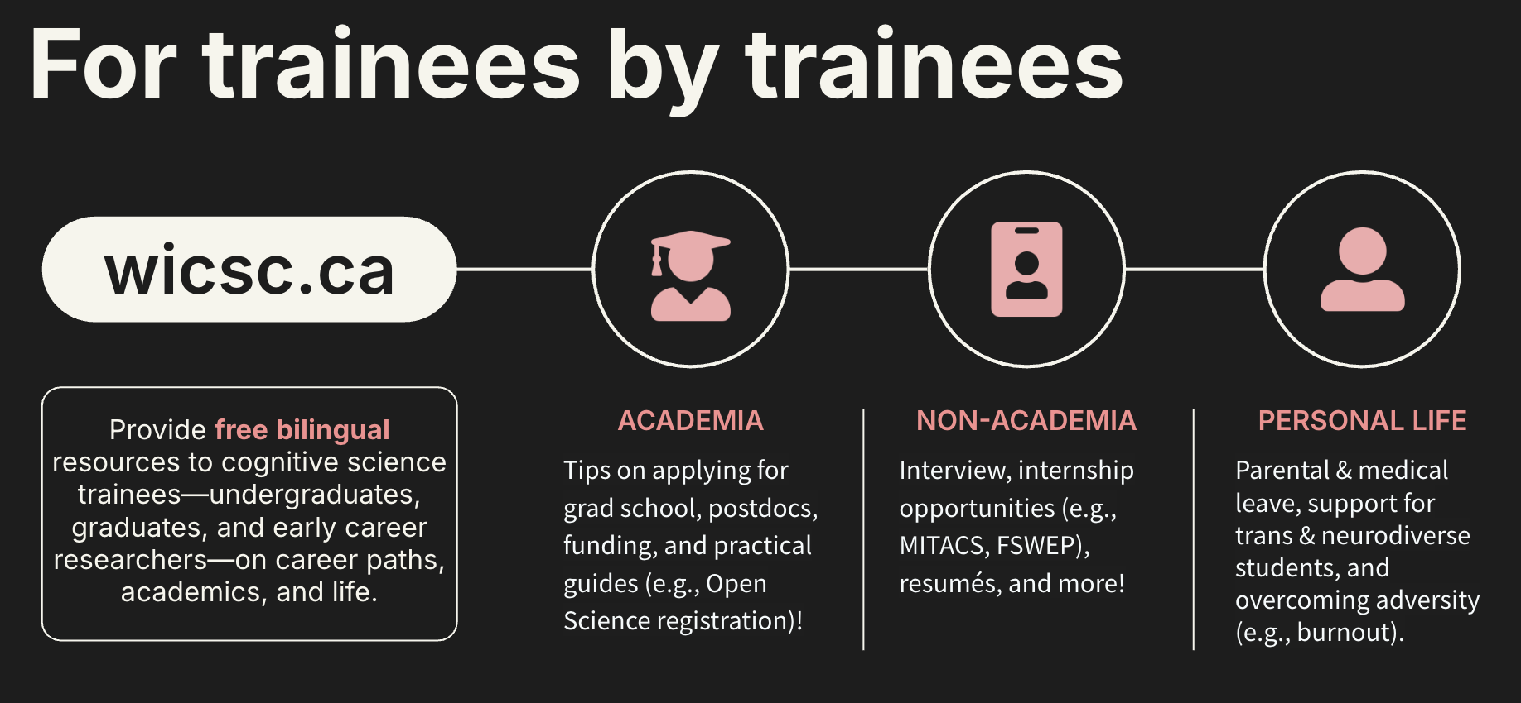

Slide 16
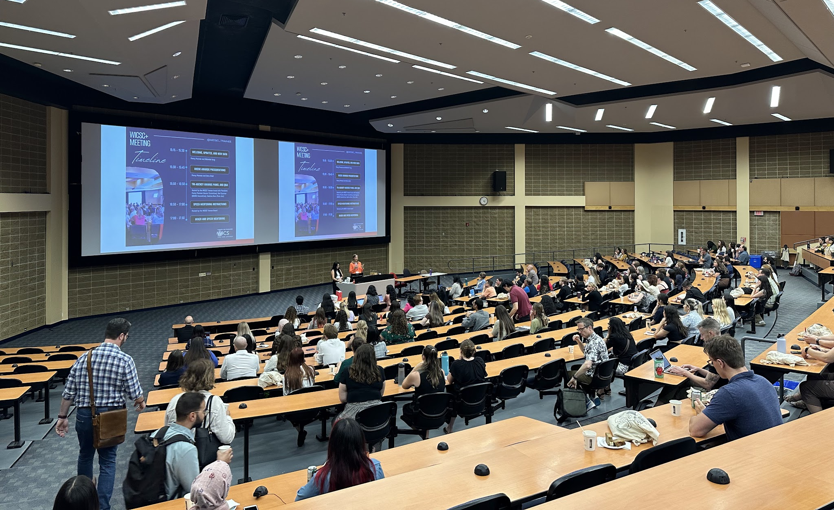

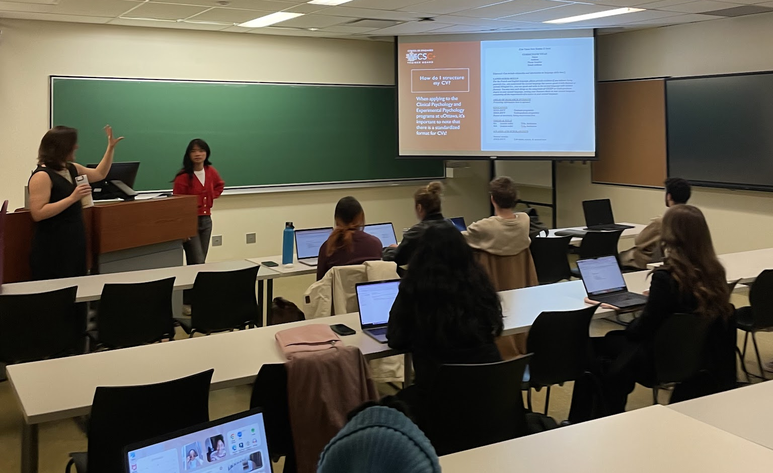

Slide 17





Slide 18
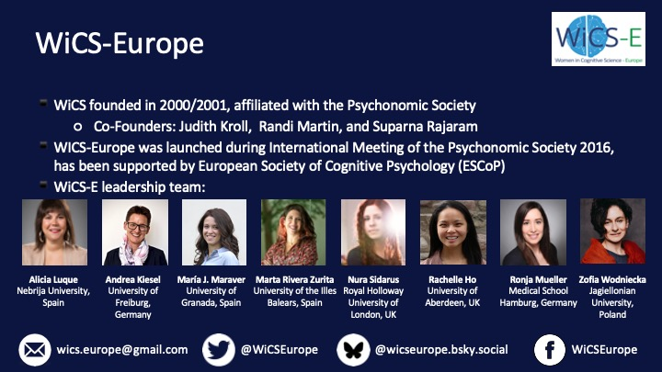

Slide 19
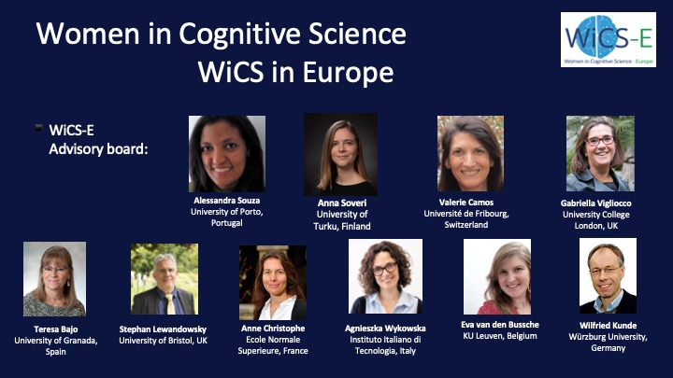

Slide 20
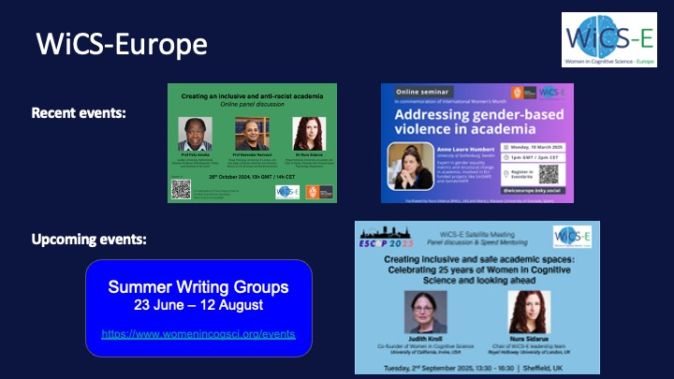

Slide 21
Meeting Agenda

Slide 22
WICSC+ 2025 Awards
Mentorship Award
The award honours a Canadian Cognitive Scientist who has demonstrated sustained, effective mentorship of students from equity-deserving groups
Small Research Grant for Jr Scientists
A seed grant to graduate students and postdoctoral fellows based in Canada to help them foster a new research collaboration with a senior or mid-career scholar at another institution in Canada or elsewhere
None for 2025
Notes:
As a reminder, this award has been reserved for the highest calibre of applications.
Thus, the committee opted not to award a networking award. But they encourage those who applied this year to apply again next year for consideration.

Slide 23
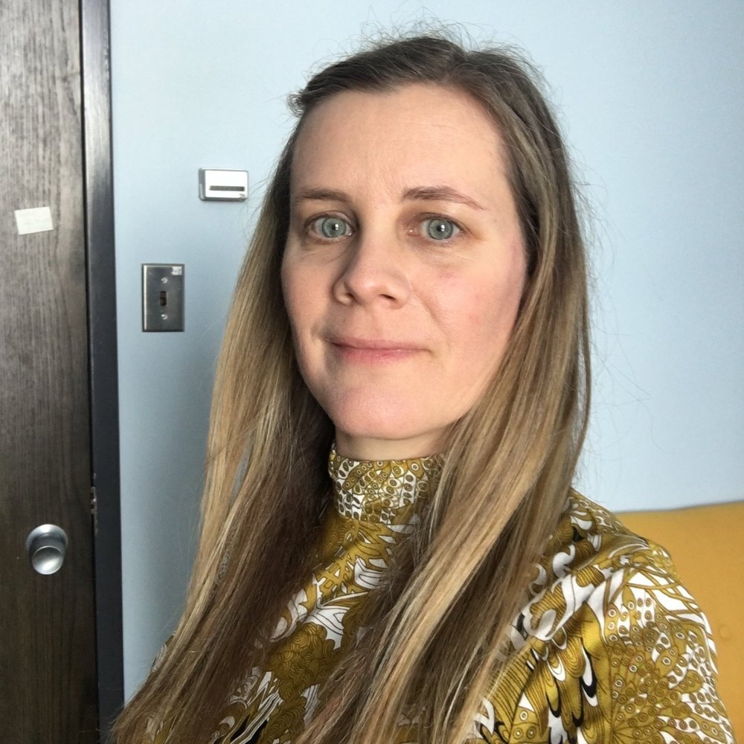
WICSC+ 2025 Awards
Mentorship Award
The award honours a Canadian Cognitive Scientist who has demonstrated sustained, effective mentorship of students from equity-deserving groups
  Dr. Dana Hayward
  University of Alberta

Slide 24
WICSC+ 2025 Awards
Dr. Dana Hayward's contribution to the training and mentorship of young scientists, particularly women and nonbinary students, is truly exceptional. Her dedication and impact extend far beyond typical expectations, setting her apart as a mentor of extraordinary caliber.
Dr. Hayward's dedication to equity is another hallmark of her unique style. She recognizes that fostering a truly supportive environment requires actively addressing systemic barriers and biases. Not only is Dr. Hayward committed to creating opportunities for her students' growth (with tangible benefits as demonstrated unequivocally in the previous sections), but she demonstrates a reciprocal commitment to her own development, pursuing ongoing education and training on topics ranging from Truth and Reconciliation to gender and sexuality. This commitment to continuous learning for her students and herself sets her apart as a mentor who is not only supportive but also actively working to dismantle barriers to success. This commitment to fostering an inclusive environment is validated by student feedback, such as this observation: "[Dr. Hayward is] careful to discuss implicit biases and systemic barriers in cognitive science, in a manner that was not shaming of a student’s blind spots, but instead educational and encouraging."

Slide 25
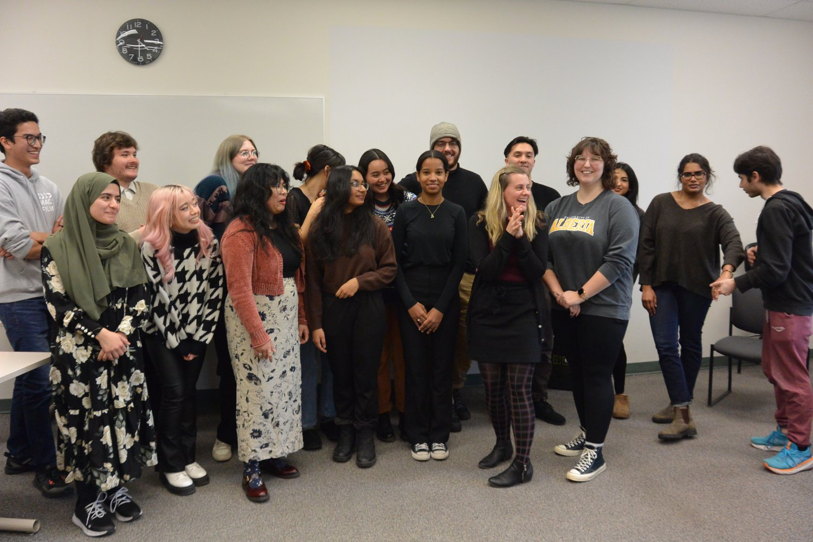
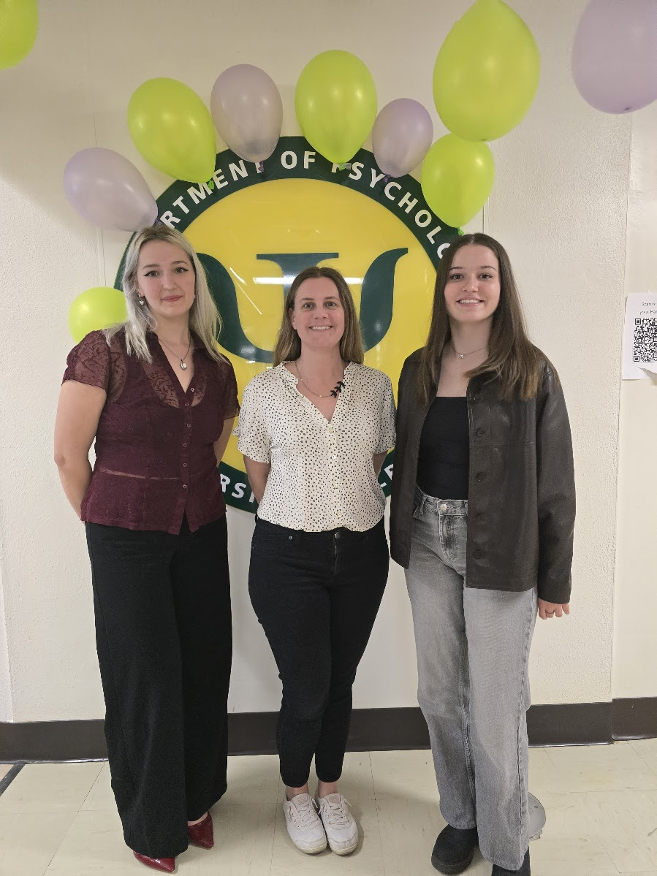
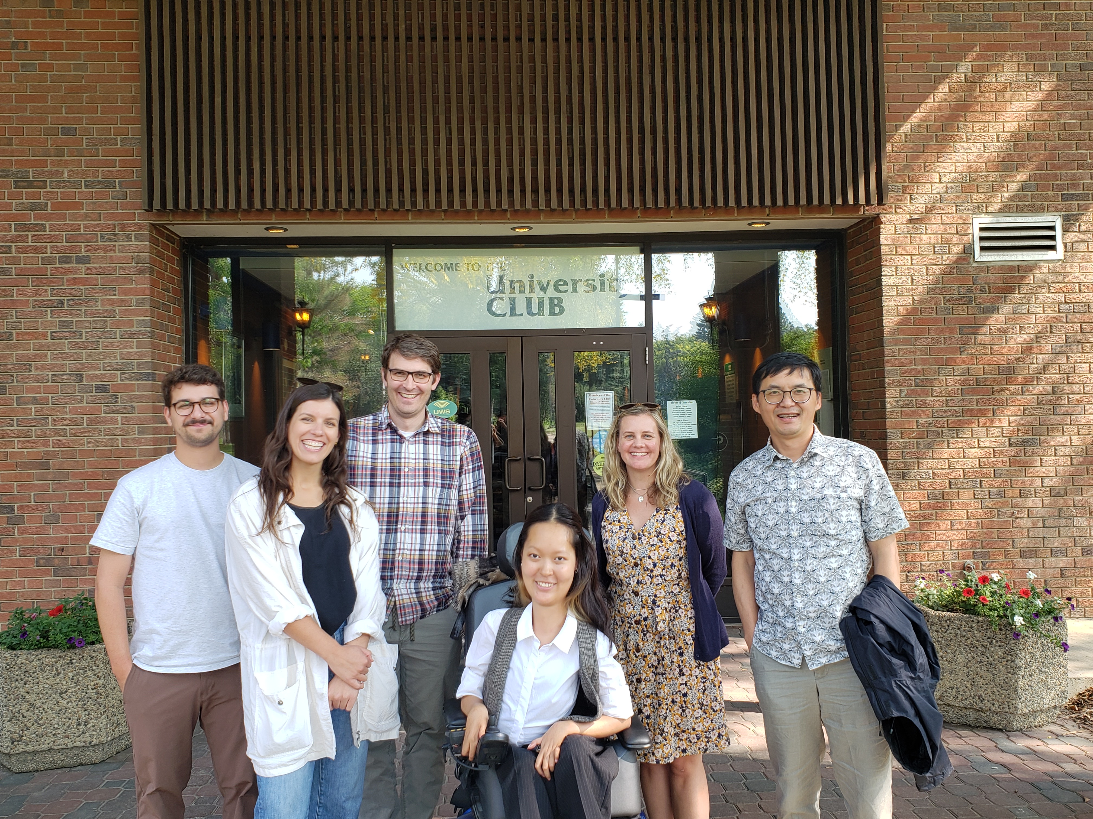
WiCSC+ Mentorship Award 2025
Dr. Dana Hayward
(University of Edmonton)
Professor Dana Hayward and trainees

Slide 26
Meeting Agenda

